Slide 1
Personalized Approach to Healthy Living
By Happy Walia

Slide 2
DISCLOSURE
I have no Financial relationships to disclose
I will not discuss off label use and/or investigational use in my presentation

Slide 3
OBJECTIVES
Discuss Approach to Healthy Living
Discuss role of alcohol in healthy living

Slide 4
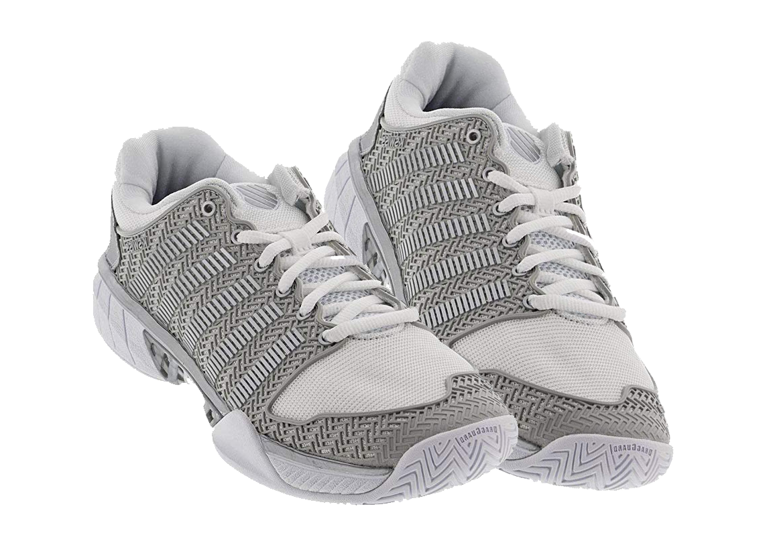

Slide 12
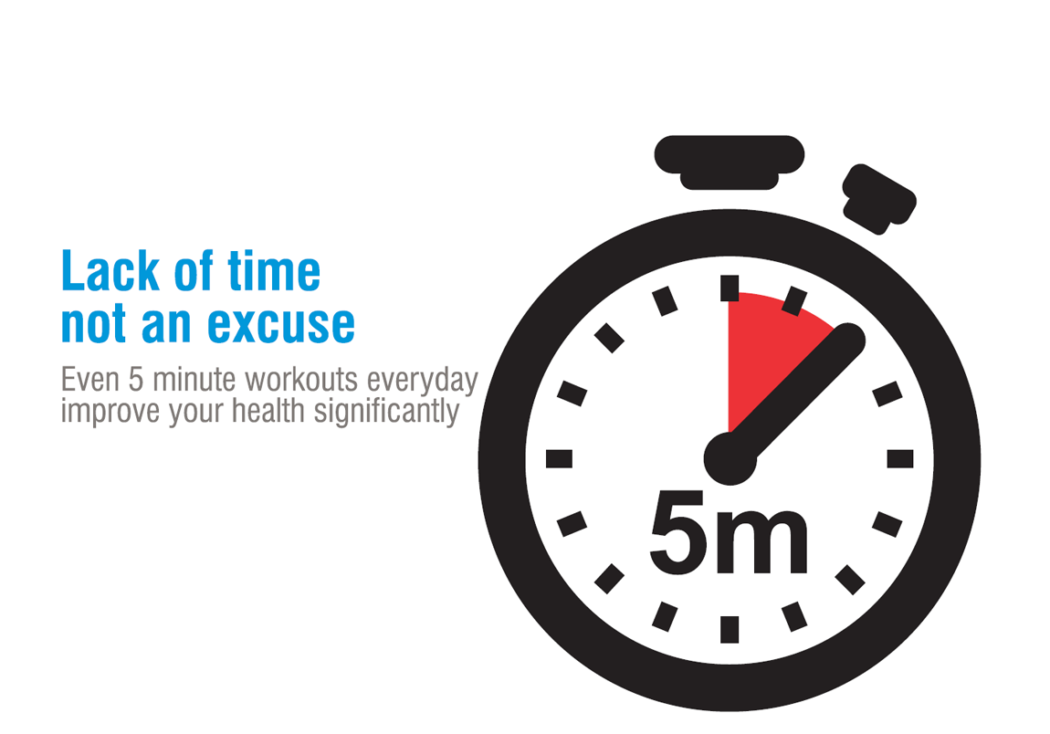

Slide 17
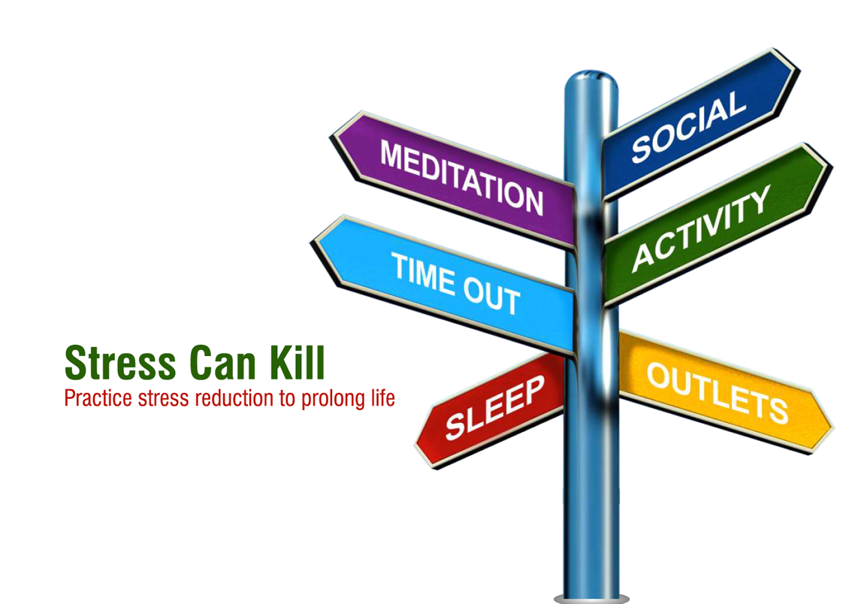

Slide 21
Recipe for healthy and long life
Sleep
Exercise
Eat Fruit and Vegetable
Surround yourself with Positive and Happy People

Slide 22
Measuring your success Q1
Which of the below is not good for your heart and Brain
Spinach and leafy greens
Readymade Meals
Walnuts

Slide 23
Measuring your success Q2
The highest levels of ellagic acid are found in
Raspberries
Apples
Bananas

Slide 24
Measuring your success Q3
Moderate Alcohol is
What you can Tolerate
Not Really Defined
One drink a day

